Slide 1
Ethics and Fairness
DATA 202 – 2021-11-05
Objectives:
Identify examples of data-driven systems that have societal impacts
Contrast incompatible notions of classifier fairness (e.g., balancing statistical parity vs error rates)
Identify ethical considerations relevant to a data-driven system

Slide 2
Logistics
Projects due today
Revision policy
Discussion
Homework
Final Project

Slide 3
Examples of data-driven technologies
Technology or task
Data
Prediction
Notes:
YouTube recommender

Slide 4
Automating High-Stakes Decisions
What credit score should be required to get a certain loan?
Which defendants should be freed until their trial?
Which candidates should get a certain job?
Which students should get into a university?
Think of some examples of unfair decisions.
How can you tell that the decision is unfair?

Slide 5
Main Point
Every policy is “unfair” by some definition.
Different stakeholders may care about different definitions
Different worldviews underlie different definitions

Slide 6
Recidivism Prediction
Bail is archaic (the rich can go free)! Is there an objective alternative?
Idea: release people unlikely to commit a crime before their trial
Northpointe COMPAS machine learning system
Data: criminal records, demographics
Prediction: will the defendant be arrested again in ≤ 2 years?
What could possibly go wrong?

Slide 7
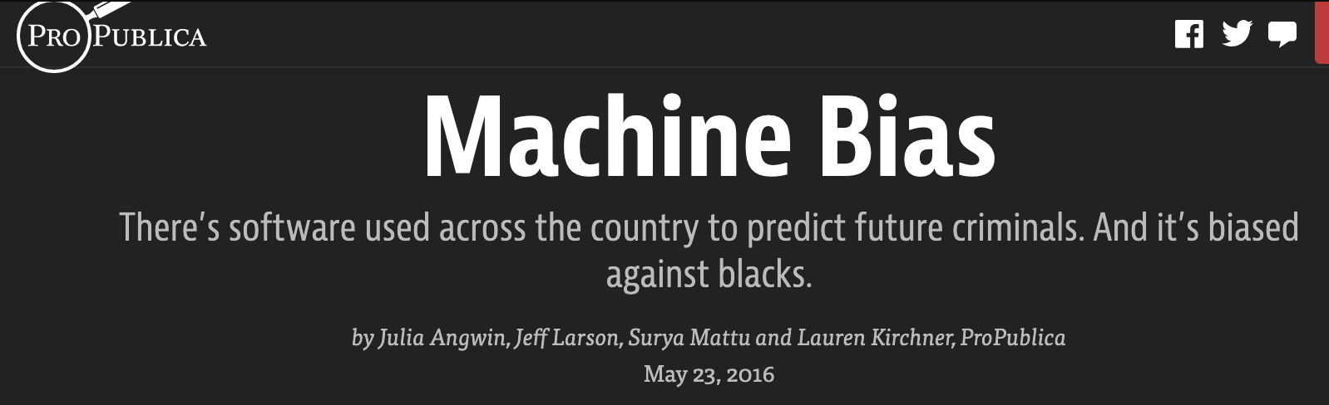
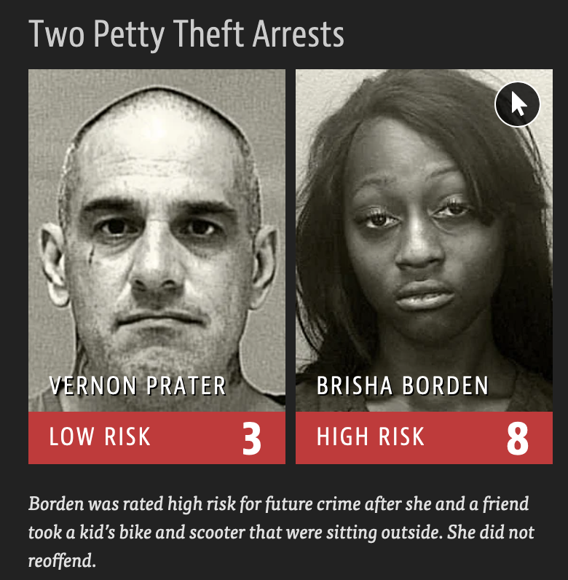
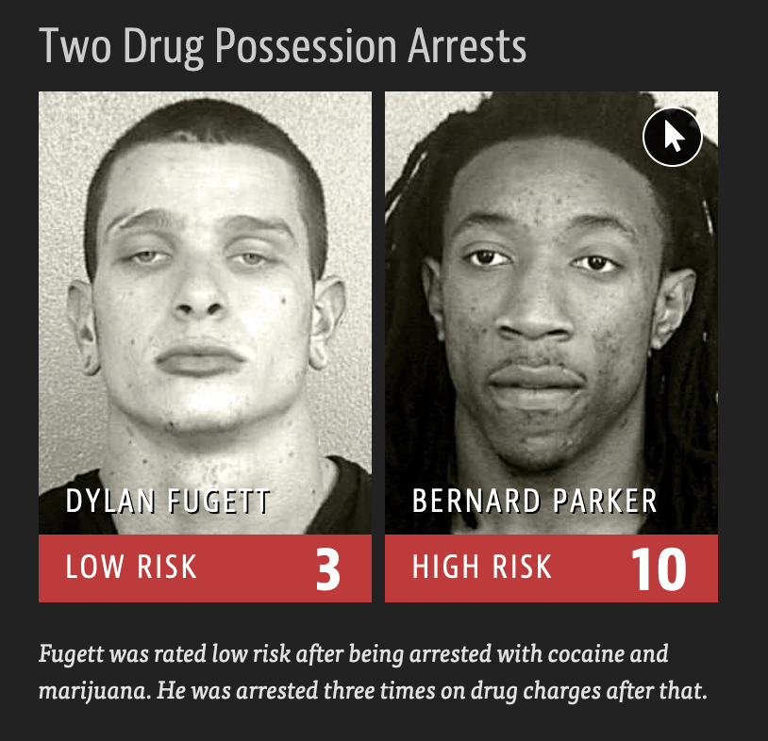

Slide 8
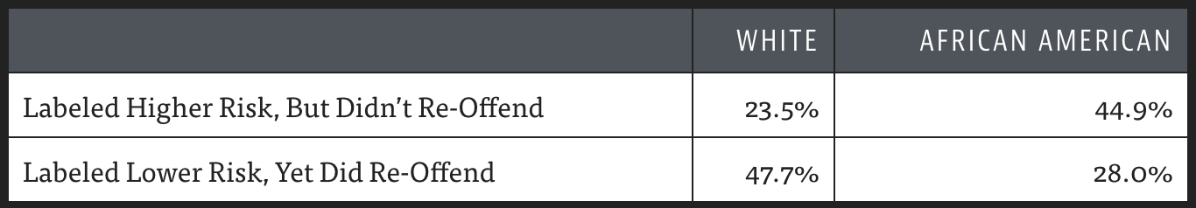
ProPublica analysis
20% of those predicted to commit violent crimes did so
Algorithm had higher accuracy (61%) when full range of crimes considered (e.g. misdemeanors)
Algorithm was more likely to falsely flag black defendants as future criminals, at almost twice the rate as white defendants
White defendants were mislabeled as low risk more often than black defendants

Slide 9
What might “fair” mean?
Equal accuracy
Equal false positive rate
Equal false negative rate

Slide 10

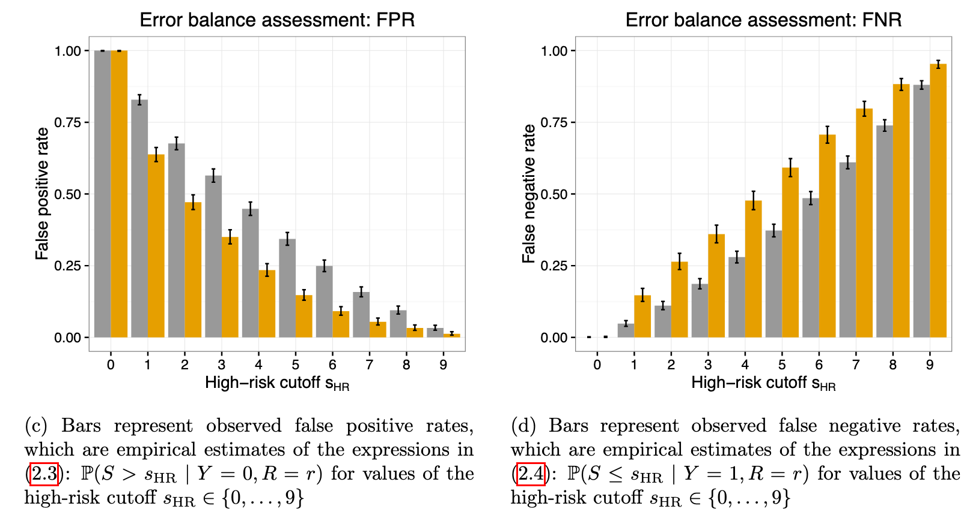

Slide 11
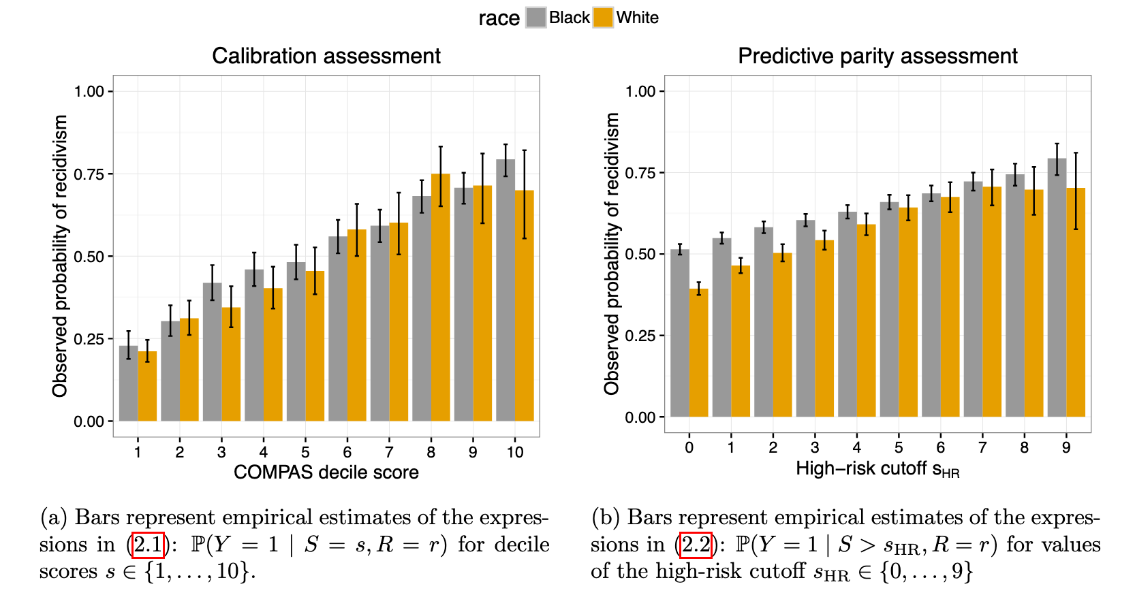
Chouldechova 2017. Fair prediction with disparate impact: A study of bias in recidivism prediction instruments

Slide 12
Confusion Matrix
https://en.wikipedia.org/wiki/Sensitivity_and_specificity

Slide 13
Confusion Matrix

Slide 14
Impossibility of Fairness(?)
Pick no more than 2 of:
Predictive parity (if it says 40% will recidivate, about 40% recidivate)
Demographic parity (offer jobs to Black / White at same rate)
Equal false positive rates
Equal false negative rates
Equal accuracy
…
Chouldechova 2017. Fair prediction with disparate impact: A study of bias in recidivism prediction instruments; extended based on slides by Arvind Narayanan

Slide 15
Automating High-Stakes Decisions
What credit score should be required to get a certain loan?
Which defendants should be freed until their trial?
Which candidates should get a certain job?
Which students should get into a university?

Slide 16
Characteristics of these decisions
Decisions try to predict the future
Will they repay the loan? Commit another crime? Succeed at the job?
Quantifiable measures used
Income, past arrests, …
Measures may not reflect reality
Arrests ≠ crimes, current income ≠ ability to pay
Measures may not reflect values
Historical redlining -> lower current income, incarceration weakens families, …
AI systems encode a policy

Slide 17
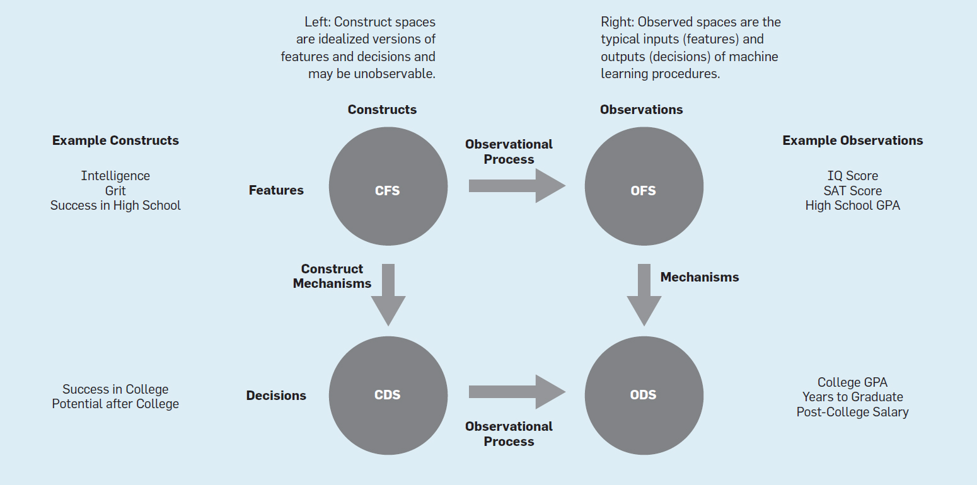
Friedler et al., 2021. The (Im)possibility of Fairness: Different Value Systems Require Different Mechanisms For Fair Decision Making

Slide 18
Goals
Individual fairness: similar people get similar decisions
Non-discrimination: similar groups get similar decisions
Algorithm (or policy) should aim to equalize, across groups:
Error rate
False positive rate
False negative rate
% classified positive
…

Slide 19
Competing worldviews
WYSIWYG
Measures are good enough (even if groups differ)
Individual fairness: “Treat similar individuals similarly”
WAE
Each group has equal merit (so any differences in measures is a flaw to correct)
Group fairness: “Equalize the outcomes between groups”
Friedler et al., 2021. The (Im)possibility of Fairness: Different Value Systems Require Different Mechanisms For Fair Decision Making

Slide 20
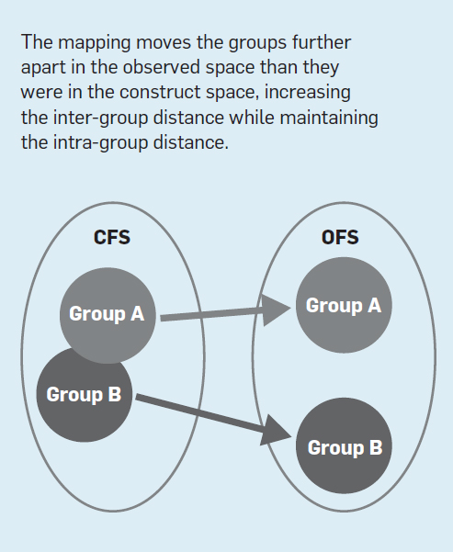
Group Skew

Slide 21
Tell my people their transgression and the house of Jacob their sins.
They seek me day after day and delight to know my ways,
like a nation that does what is right and does not abandon the justice of their God. They ask me for righteous judgments; they delight in the nearness of God.” …
Isn’t this the fast I choose: To break the chains of wickedness, to untie the ropes of the yoke, to set the oppressed free, and to tear off every yoke? Is it not to share your bread with the hungry, to bring the poor and homeless into your house, to clothe the naked when you see him, and not to ignore your own flesh and blood?
…
If you get rid of the yoke among you,
the finger-pointing and malicious speaking,
and if you offer yourself to the hungry, and satisfy the afflicted one,
then your light will shine in the darkness,
and your night will be like noonday.
Isaiah 58 (CSB)
What sorts of automated decision policies would satisfy Isaiah’s demands?
What fairness worldview is Isaiah using?

Slide 22
Are human lives predictable?
Hundreds of researchers attempted to predict six life outcomes, such as a child’s grade point average and whether a family would be evicted from their home. These researchers used machine-learning methods optimized for prediction, and they drew on a vast dataset that was painstakingly collected by social scientists over 15 y. However, no one made very accurate predictions. For policymakers considering using predictive models in settings such as criminal justice and child-protective services, these results raise a number of concerns. Additionally, researchers must reconcile the idea that they understand life trajectories with the fact that none of the predictions were very accurate.
Salganik et al. 2020. Measuring the predictability of life outcomes with a scientific mass collaboration

Slide 23
Fairness vs Free Will
How does free will intersect fairness definitions we’ve considered?

Slide 24
Not just classifiers…
A company uses a machine learning algorithm to determine which job advertisement to display for users searching for technology jobs. Based on past results, the algorithm tends to display lower paying jobs for women than for men (after controlling for other characteristics than gender).
What ethical considerations might be considered when reviewing this algorithm?

